Slide 1
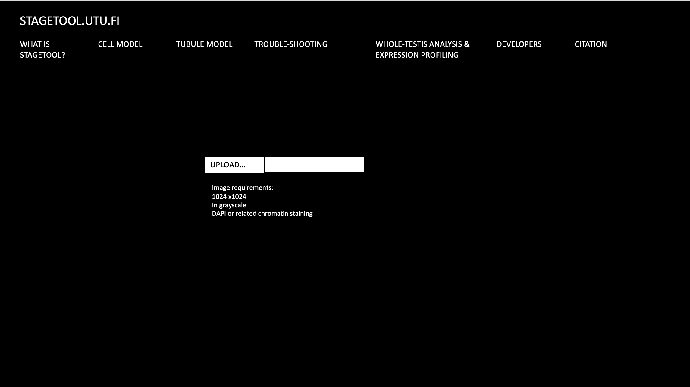
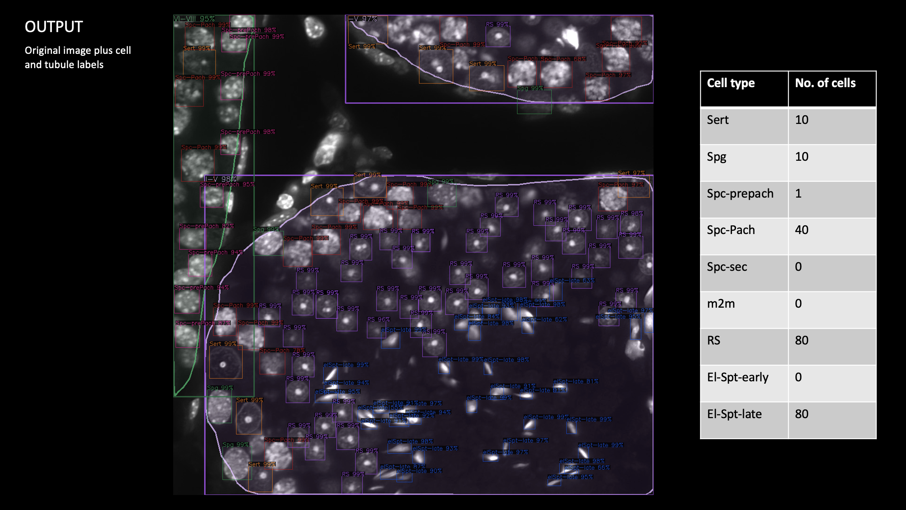
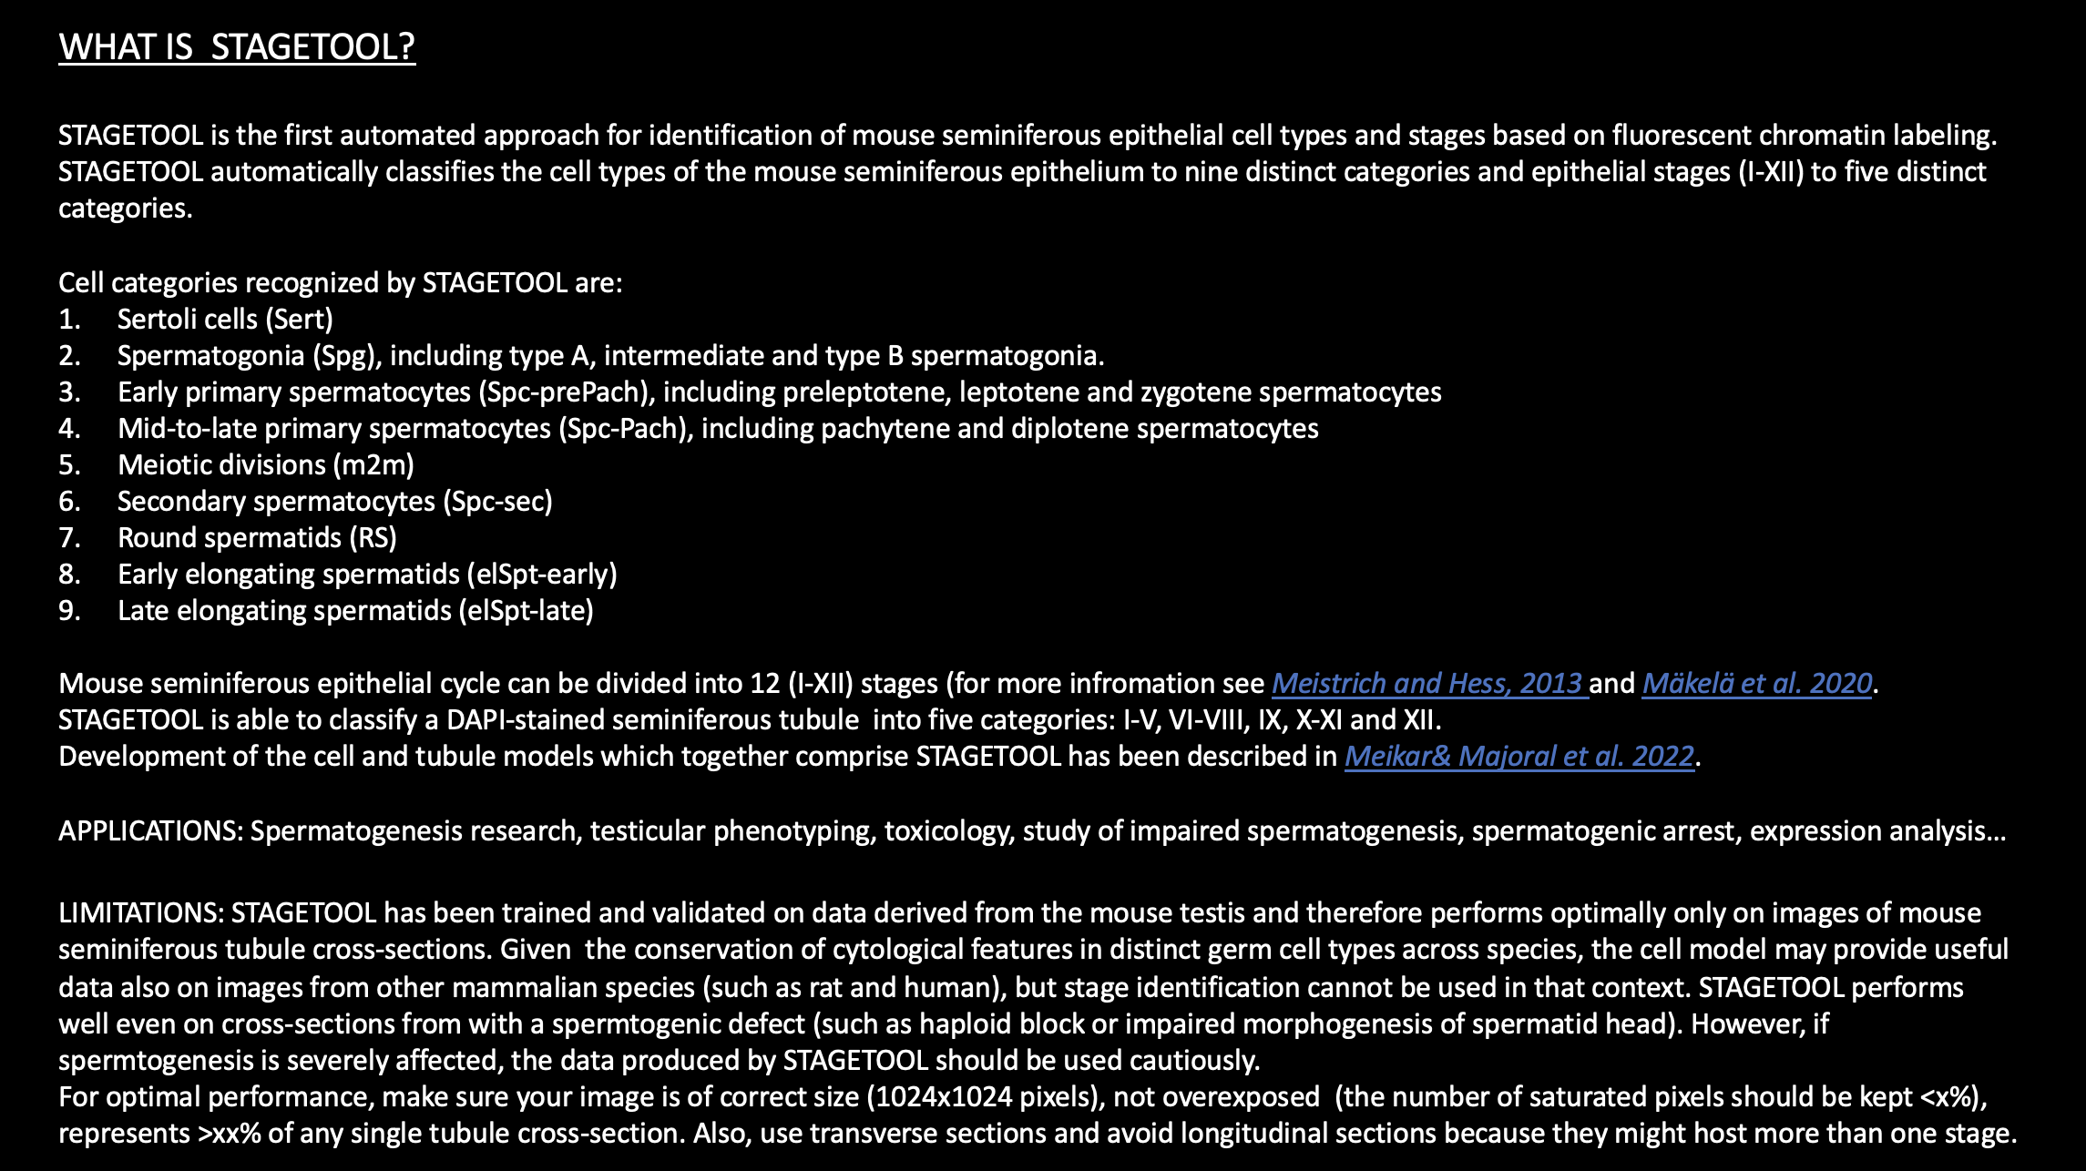
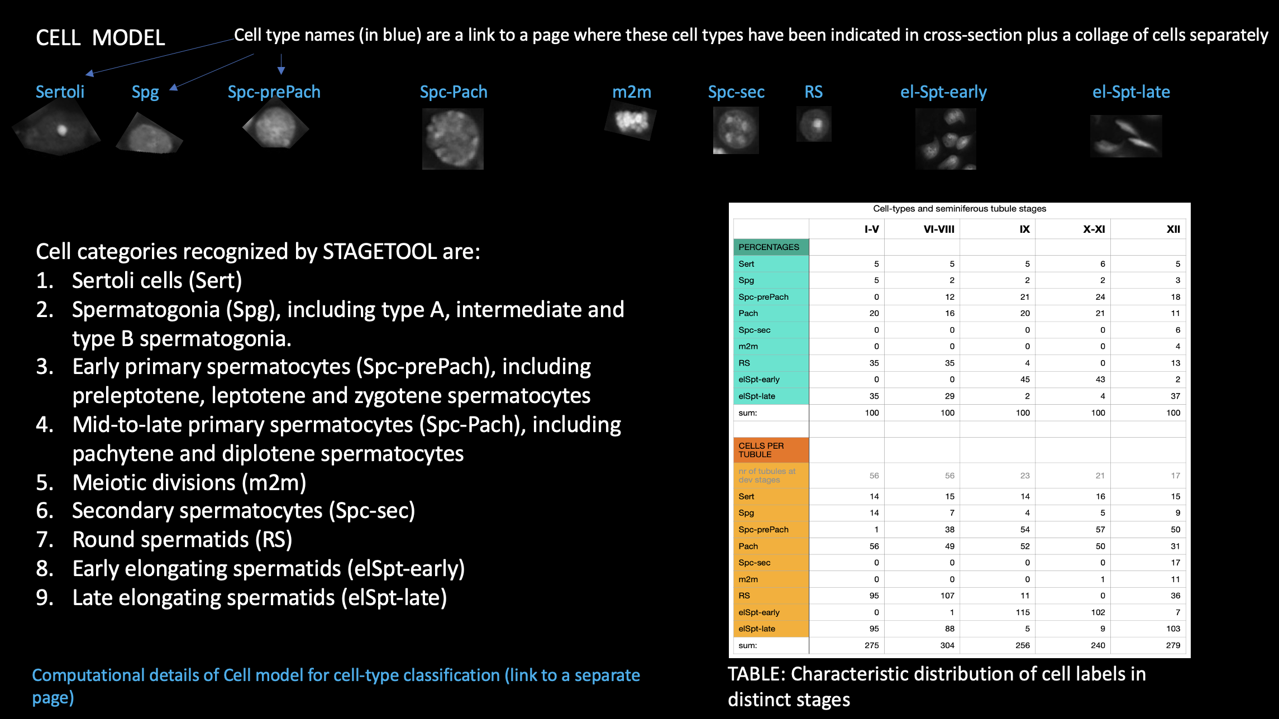
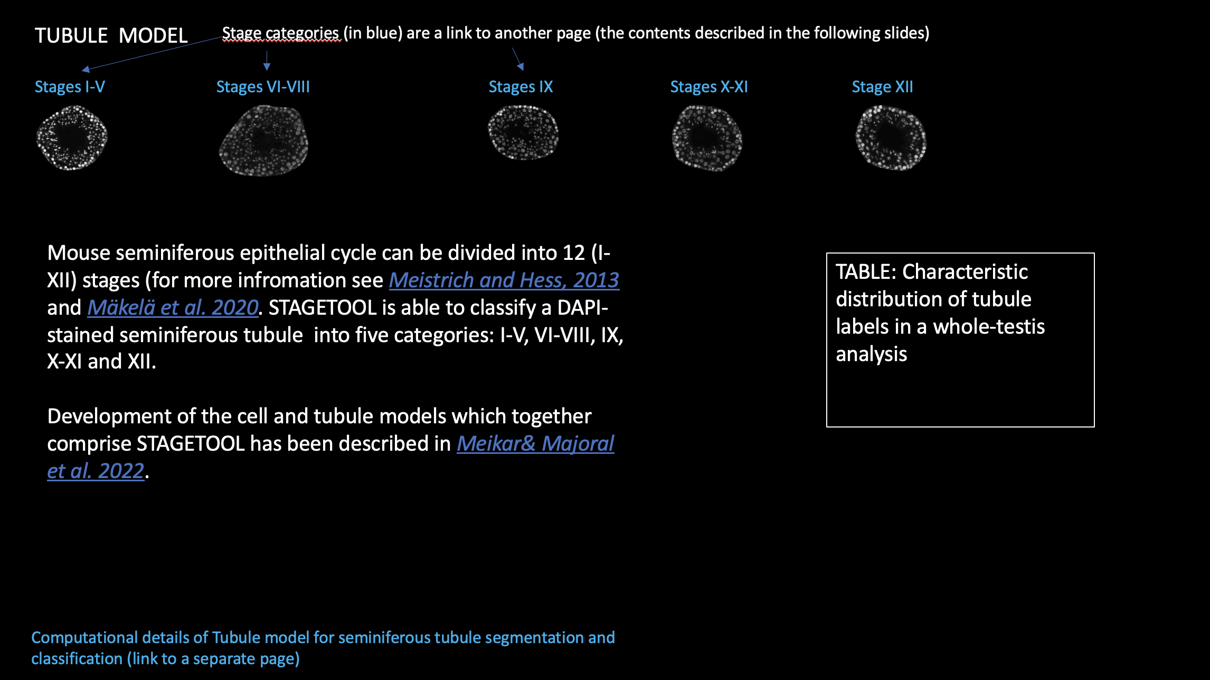
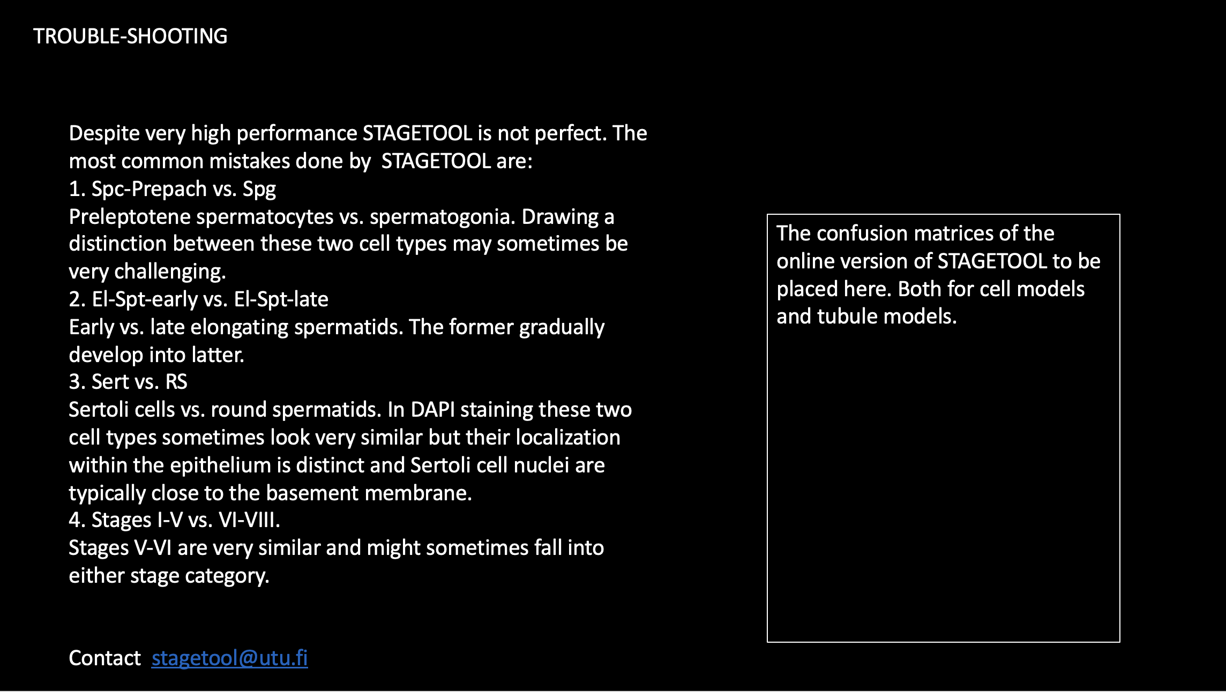


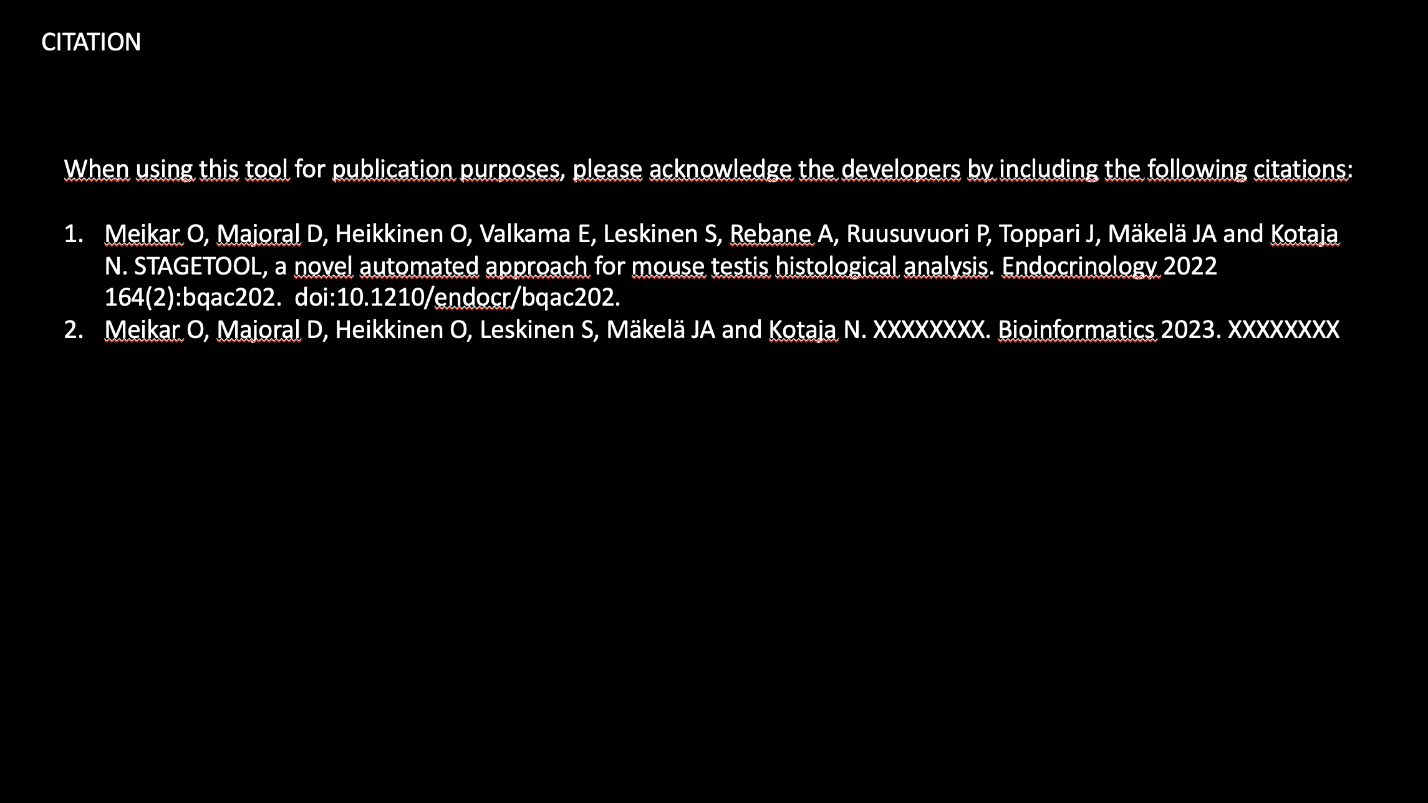

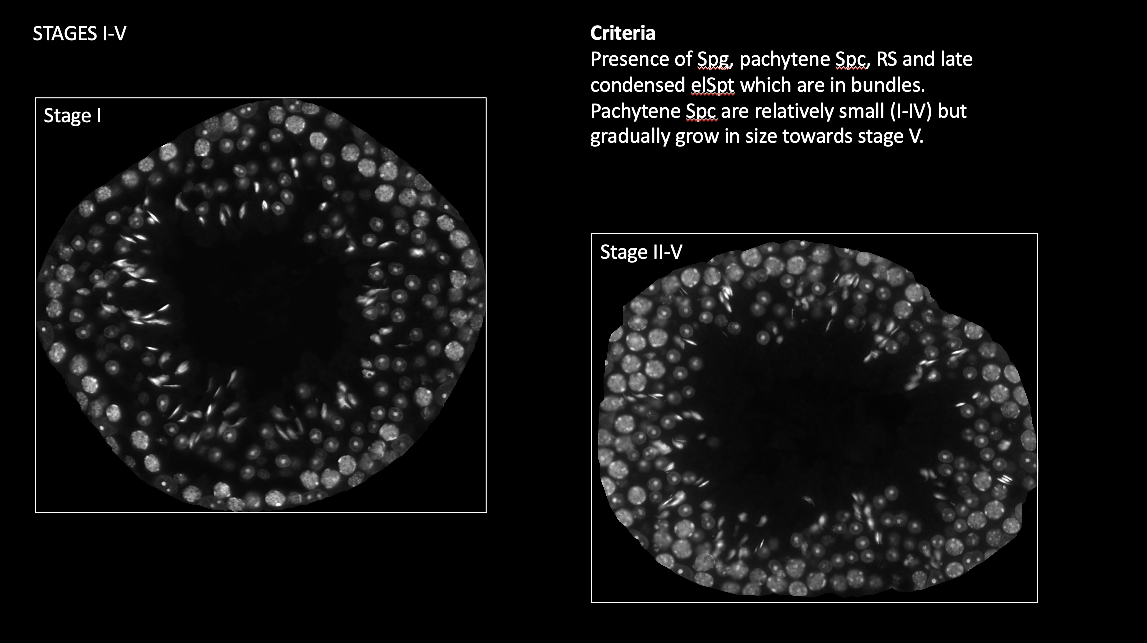


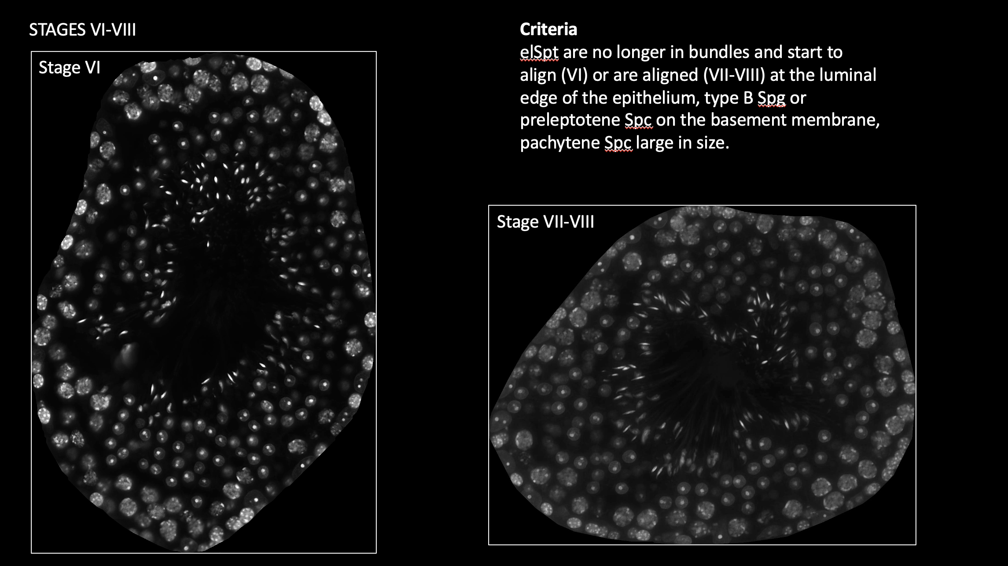


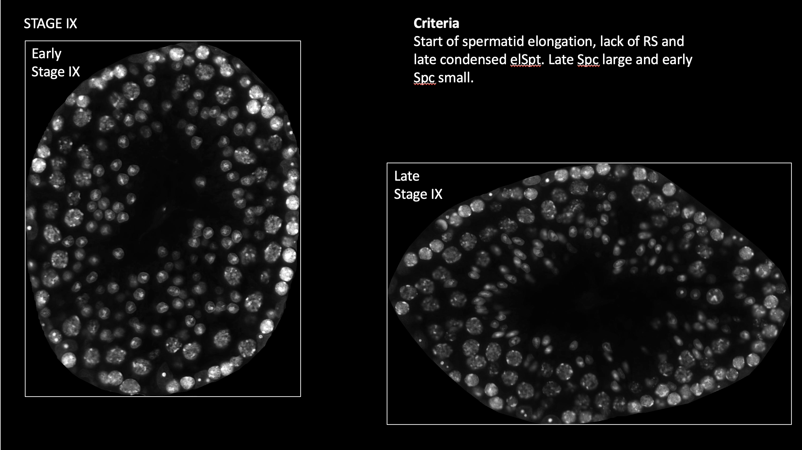

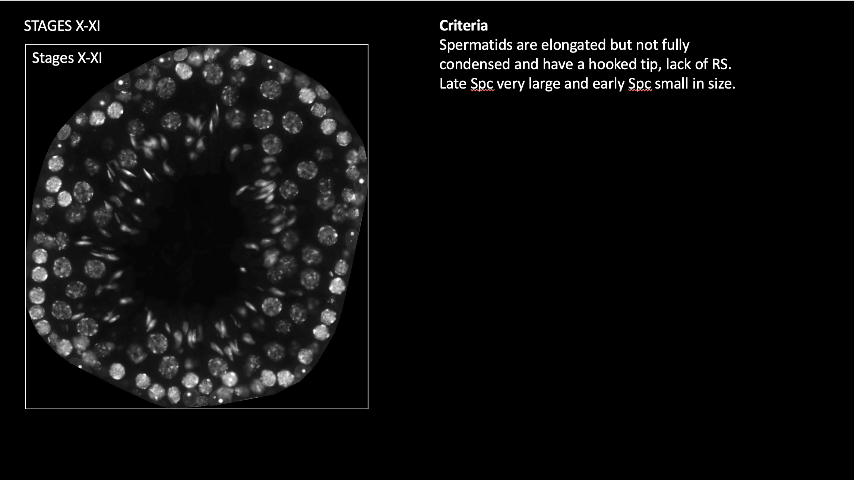


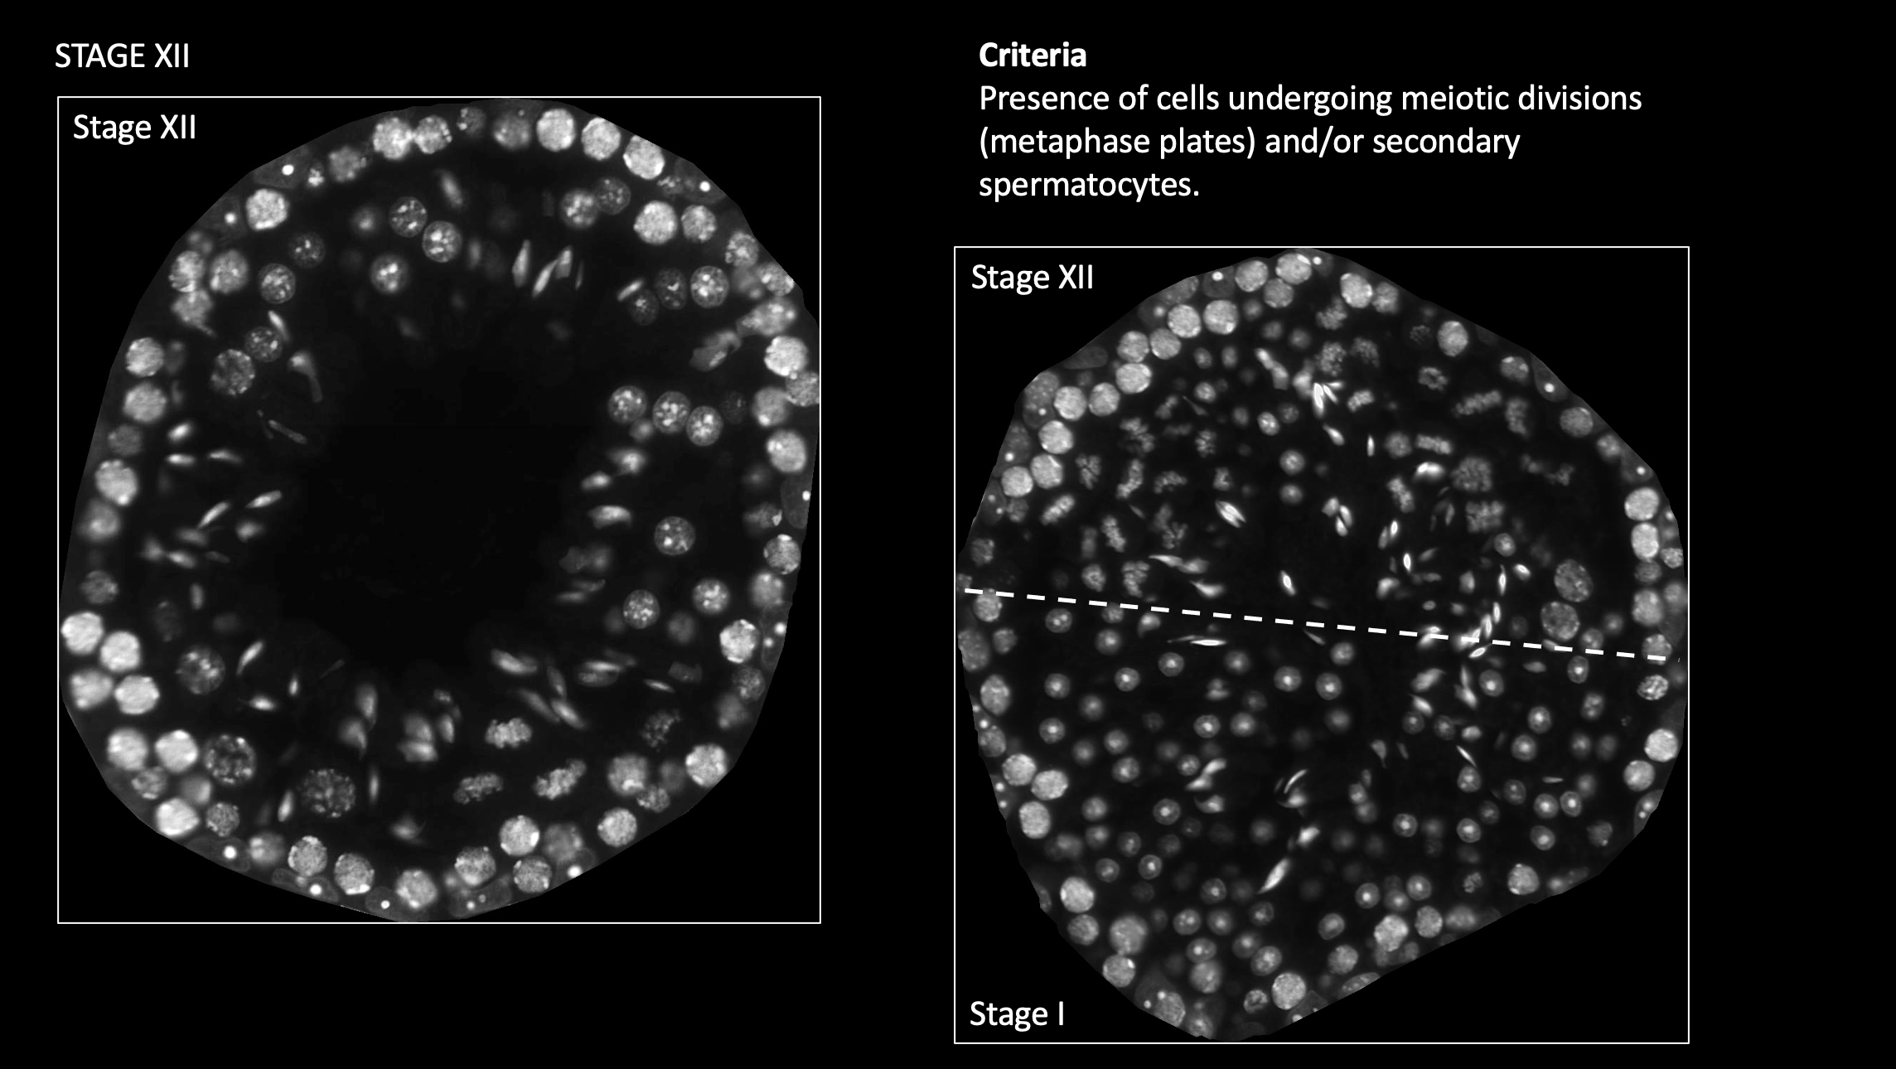

DESIGN OF STAGETOOL.UTU.FI

Slide 2
STAGETOOL.UTU.FI
WHAT IS STAGETOOL?
CELL MODEL
TUBULE MODEL
TROUBLE-SHOOTING
WHOLE-TESTIS ANALYSIS & EXPRESSION PROFILING
DEVELOPERS
CITATION
Example image 1 (these are links to example cross-sections showing how stagetool should work)
Example image 2
Example image 3
UPLOAD…
Image requirements:
1024 x1024
⨯400 magnification
DAPI or related chromatin staining

Slide 3
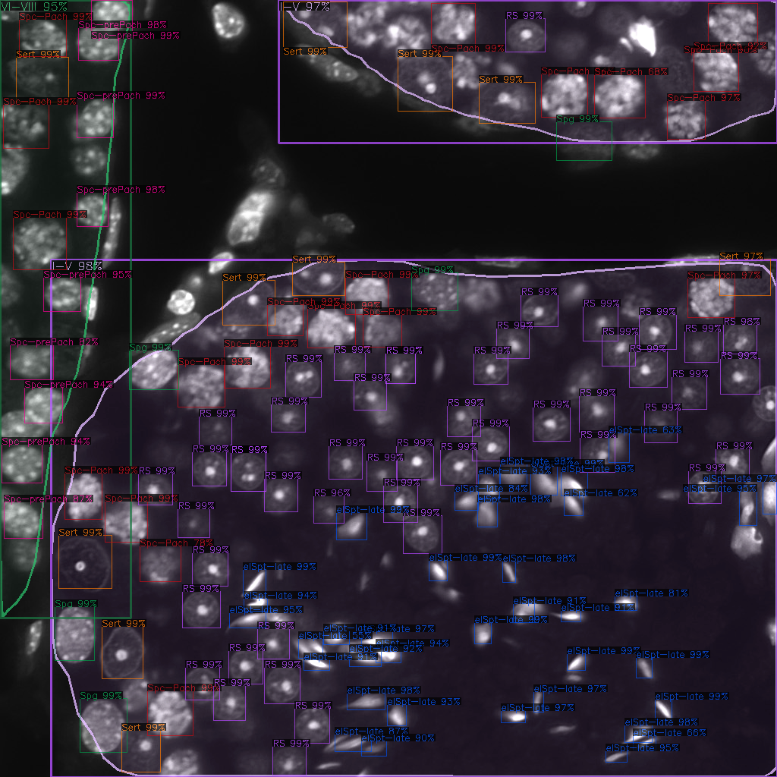
Tubule 1: VI-VIII
Tubule 2: I-V
OUTPUT
Cell type | No. of cells
Sert | 1
Spg | 0
Spc-prepach | 9
Spc-Pach | 3
Spc-sec | 0
m2m | 0
RS | 0
El-Spt-early | 0
El-Spt-late | 0
Cell type | No. of cells
Sert | 3
Spg | 1
Spc-prepach | 0
Spc-Pach | 7
Spc-sec | 0
m2m | 0
RS | 1
El-Spt-early | 0
El-Spt-late | 0
Original image plus cell and tubule labels
3 tubules:
Tubule 1: VI-VIII
Tubule 2: I-V
Tubule 3: I-V
Tubule 3: I-V
Cell type | No. of cells
Sert | 6
Spg | 4
Spc-prepach | 0
Spc-Pach | 10
Spc-sec | 0
m2m | 0
RS | 55
El-Spt-early | 0
El-Spt-late | 44
Download image
Download data as .csv
Labeled with Stagetool
Stagetool.utu.fi

Slide 4
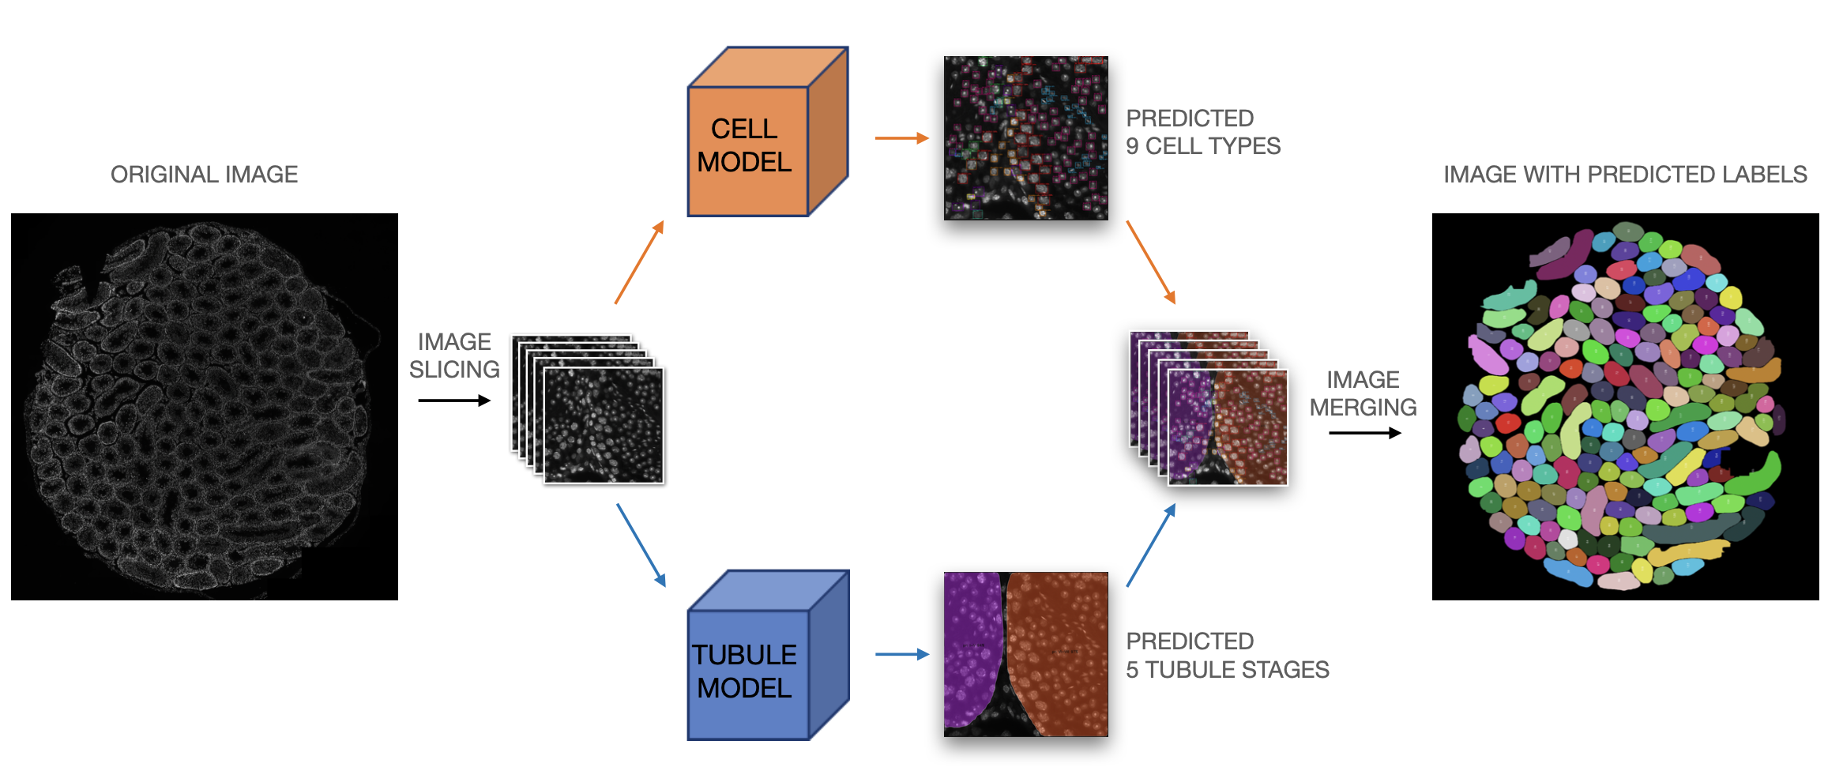
WHAT IS STAGETOOL?
STAGETOOL is the first automated approach for identification of mouse seminiferous epithelial cell types and stages based on fluorescent chromatin labeling.
STAGETOOL automatically classifies the cell types of the mouse seminiferous epithelium to nine distinct categories and epithelial stages (I-XII) to five distinct categories.
Cell categories recognized by STAGETOOL are:
Sertoli cells (Sert)
Spermatogonia (Spg), including type A, intermediate and type B spermatogonia.
Early primary spermatocytes (Spc-prePach), including preleptotene, leptotene and zygotene spermatocytes
Mid-to-late primary spermatocytes (Spc-Pach), including pachytene and diplotene spermatocytes
Meiotic divisions (m2m)
Secondary spermatocytes (Spc-sec)
Round spermatids (RS)
Early elongating spermatids (elSpt-early)
Late elongating spermatids (elSpt-late)
Mouse seminiferous epithelial cycle can be divided into 12 (I-XII) stages (for more infromation see Meistrich and Hess, 2013 and Mäkelä et al. 2020. STAGETOOL is able to classify a DAPI-stained seminiferous tubule into five categories: I-V, VI-VIII, IX, X-XI and XII.
Development of the cell and tubule models which together comprise STAGETOOL has been described in Meikar& Majoral et al. 2022.
APPLICATIONS: Spermatogenesis research, testicular phenotyping, toxicology, study of impaired spermatogenesis, spermatogenic arrest, expression analysis…
LIMITATIONS: STAGETOOL has been trained and validated on data derived from the mouse testis and therefore performs optimally only on images of mouse seminiferous tubule cross-sections. Given the conservation of cytological features in distinct germ cell types across species, the cell model may provide useful data also on images from other mammalian species (such as rat and human), but stage identification cannot be used in that context. STAGETOOL performs well even on cross-sections from with a spermtogenic defect (such as haploid block or impaired morphogenesis of spermatid head). However, if spermtogenesis is severely affected, the data produced by STAGETOOL should be interpreted with caution.
For optimal performance, make sure your image is of correct size (1024x1024 pixels), not overexposed (the number of saturated pixels should be kept <x%) and representing >xx% of any single tubule cross-section. It is critically importnt to use ⨯400 magnification (10⨯ ocular plus 40⨯ objective). Also, use of transverse sections and avoid longitudinal sections because they might host more than one stage.

Slide 5






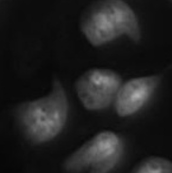


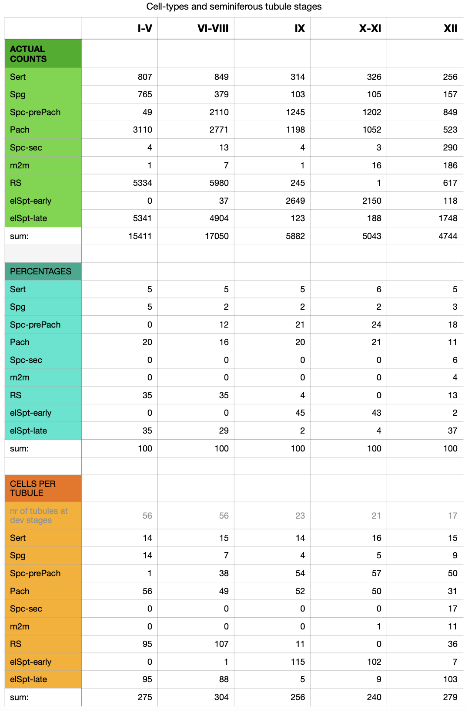
CELL MODEL
Sertoli Spg Spc-prePach Spc-Pach m2m Spc-sec RS el-Spt-early el-Spt-late
Cell type names (in blue) are a link to a page where these cell types have been indicated in cross-section plus a collage of cells separately
Cell categories recognized by STAGETOOL are:
Sertoli cells (Sert)
Spermatogonia (Spg), including type A, intermediate and type B spermatogonia.
Early primary spermatocytes (Spc-prePach), including preleptotene, leptotene and zygotene spermatocytes
Mid-to-late primary spermatocytes (Spc-Pach), including pachytene and diplotene spermatocytes
Meiotic divisions (m2m)
Secondary spermatocytes (Spc-sec)
Round spermatids (RS)
Early elongating spermatids (elSpt-early)
Late elongating spermatids (elSpt-late)
TABLE: Characteristic distribution of cell labels in distinct stages

Slide 6
SERTOLI CELLS (Sert)
A tubule cross-ssection image where Sertoli cells have been indicated with a box and label plus a collage of Sertoli cells separately

Slide 7
SPERMATOGONIA (Spg)
A tubule cross-ssection image where spermatogonia have been indicated with a box and label plus a collage of spermatogonia separately

Slide 8
PRELEPTOTENE, LEPTOTENE AND ZYGOTENE SPERMATOCYTES (Spc-prePach)
The same as for the previous slides

Slide 9
PACHYTENE AND DIPLOTENE SPERMATOCYTES (Spc-Pach)
The same as for the previous slides

Slide 10
MEIOTIC DIVISIONS (m2m)
The same as for the previous slides

Slide 11
SECONDARY SPERMATOCYTES (Spc-sec)
The same as for the previous slides

Slide 12
ROUND SPERMATIDS (RS)
The same as for the previous slides

Slide 13
EARLY ELONGATING SPERMATIDS (el-Spt-early)
The same as for the previous slides

Slide 14
LATE ELONGATING SPERMATIDS (el-Spt-late)
The same as for the previous slides

Slide 15
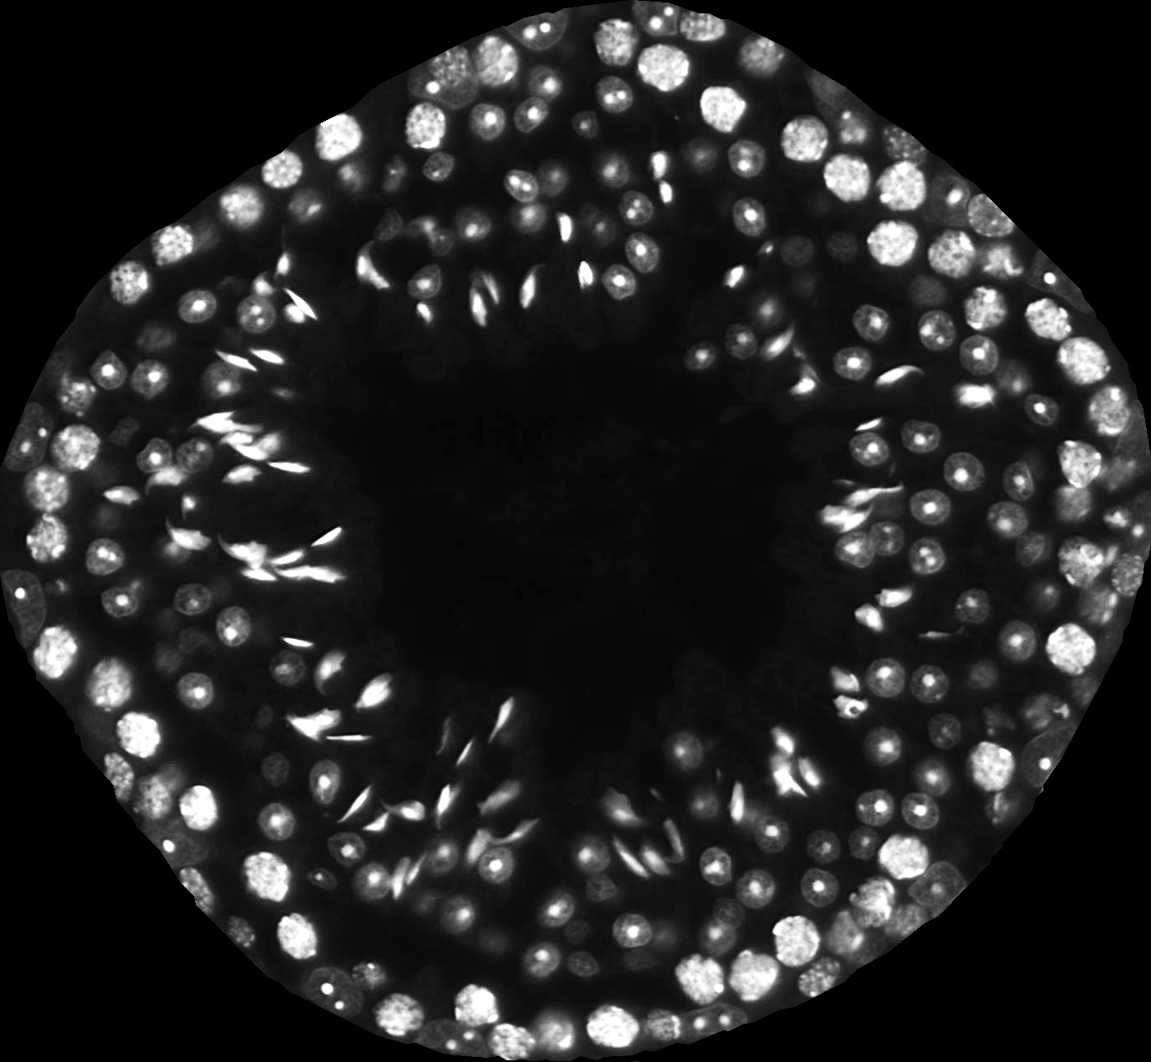
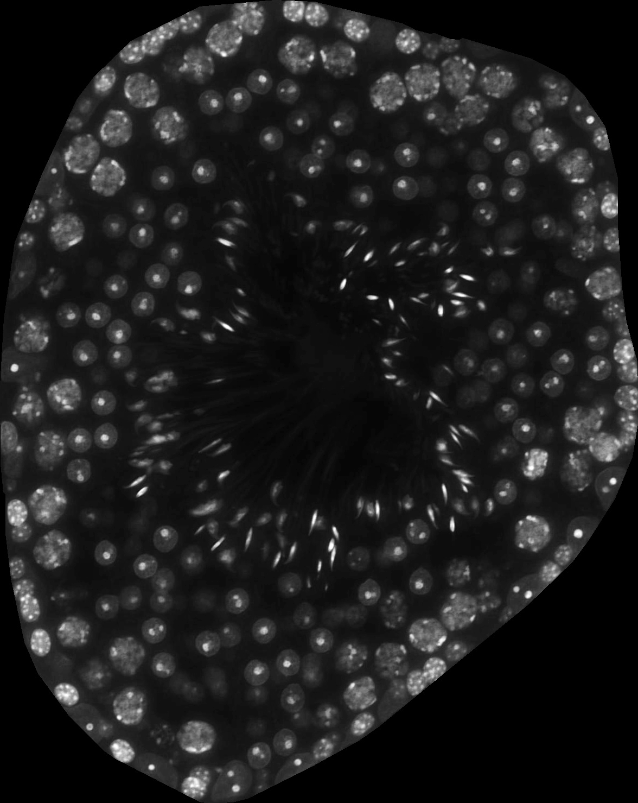
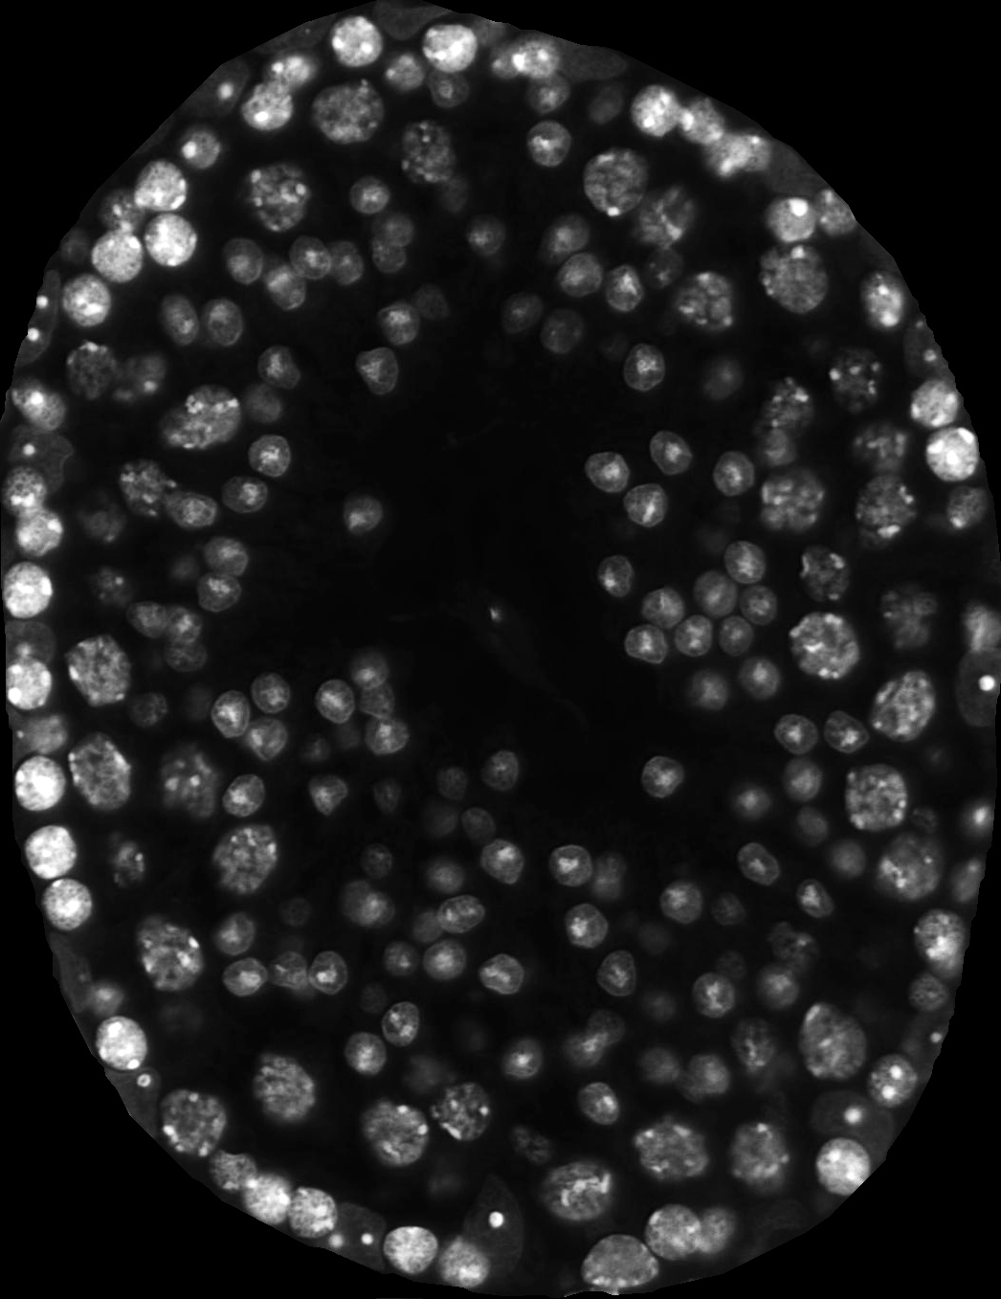
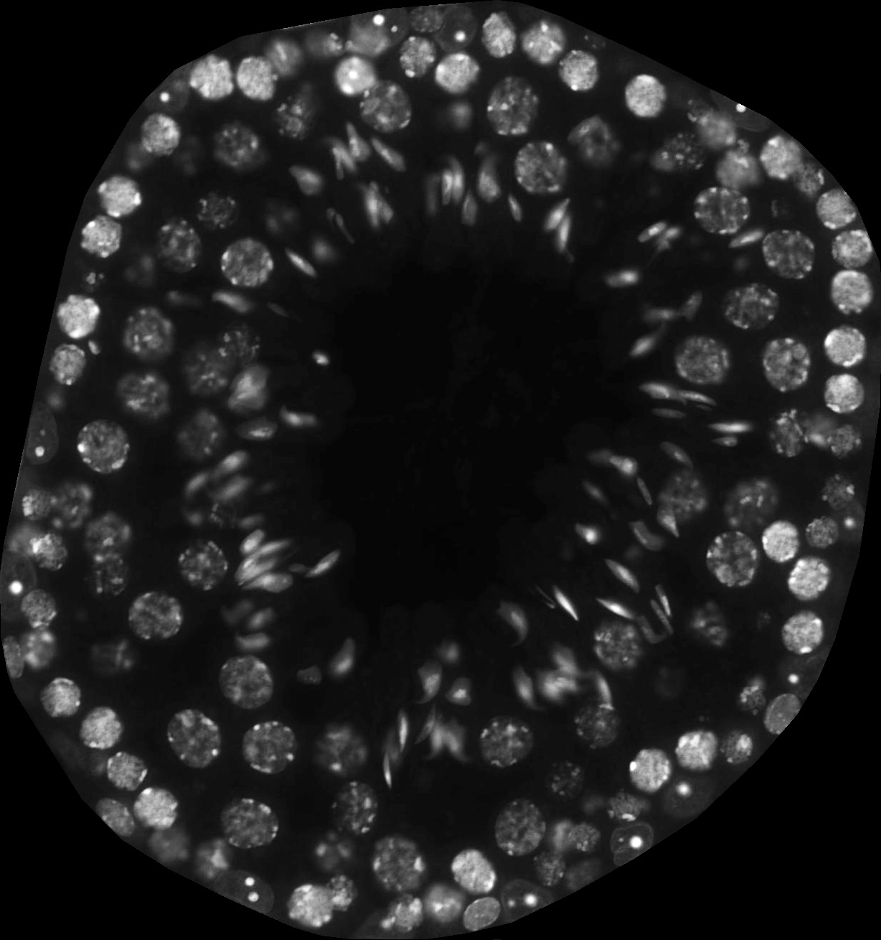
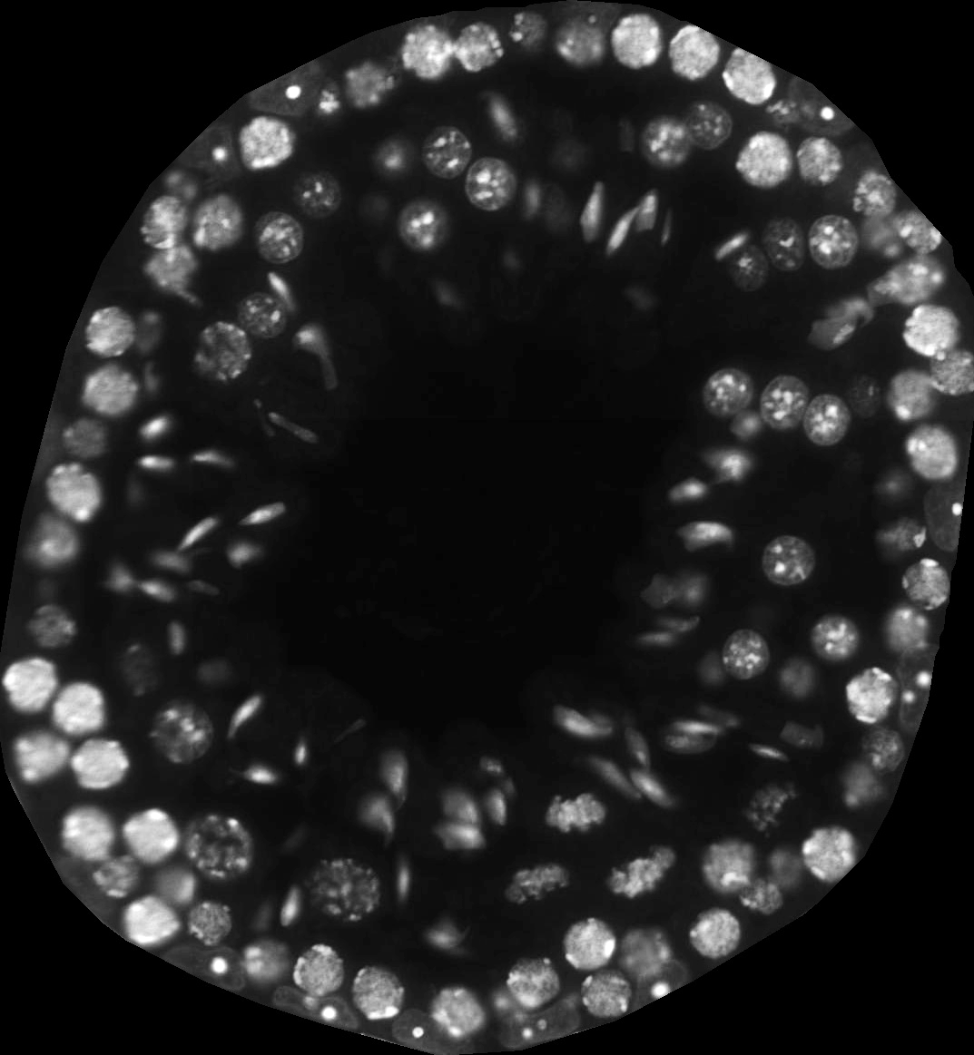
TUBULE MODEL
Stages I-V Stages VI-VIII Stages IX Stages X-XI Stage XII
Stage categories (in blue) are a link to another page (the contents described in the following slides)
Mouse seminiferous epithelial cycle can be divided into 12 (I-XII) stages (for more infromation see Meistrich and Hess, 2013 and Mäkelä et al. 2020. STAGETOOL is able to classify a DAPI-stained seminiferous tubule into five categories: I-V, VI-VIII, IX, X-XI and XII.
Development of the cell and tubule models which together comprise STAGETOOL has been described in Meikar& Majoral et al. 2022.
TABLE: Characteristic distribution of tubule labels in a whole-testis analysis

Slide 16
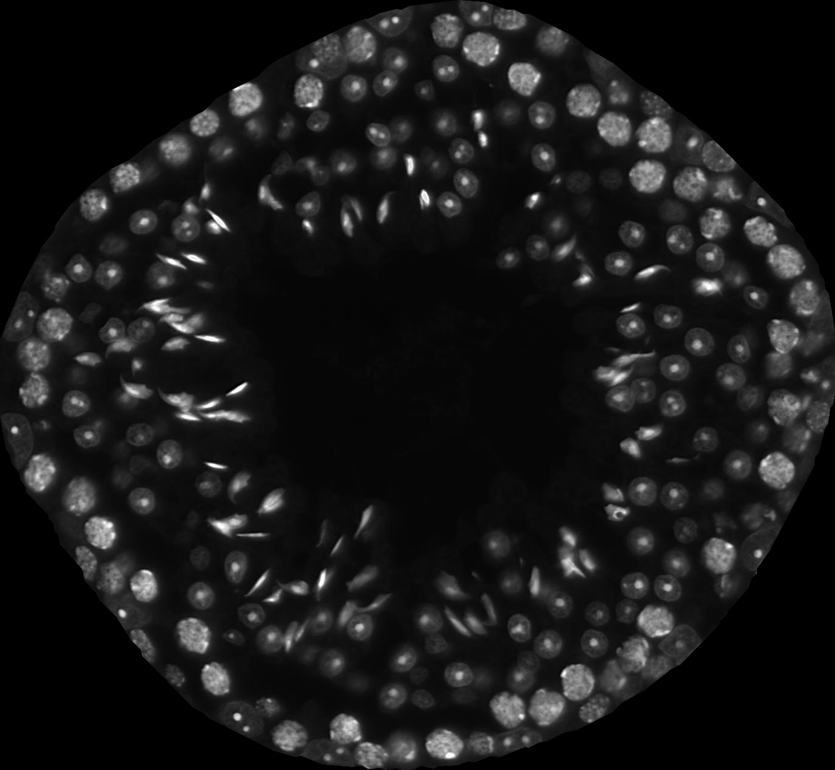
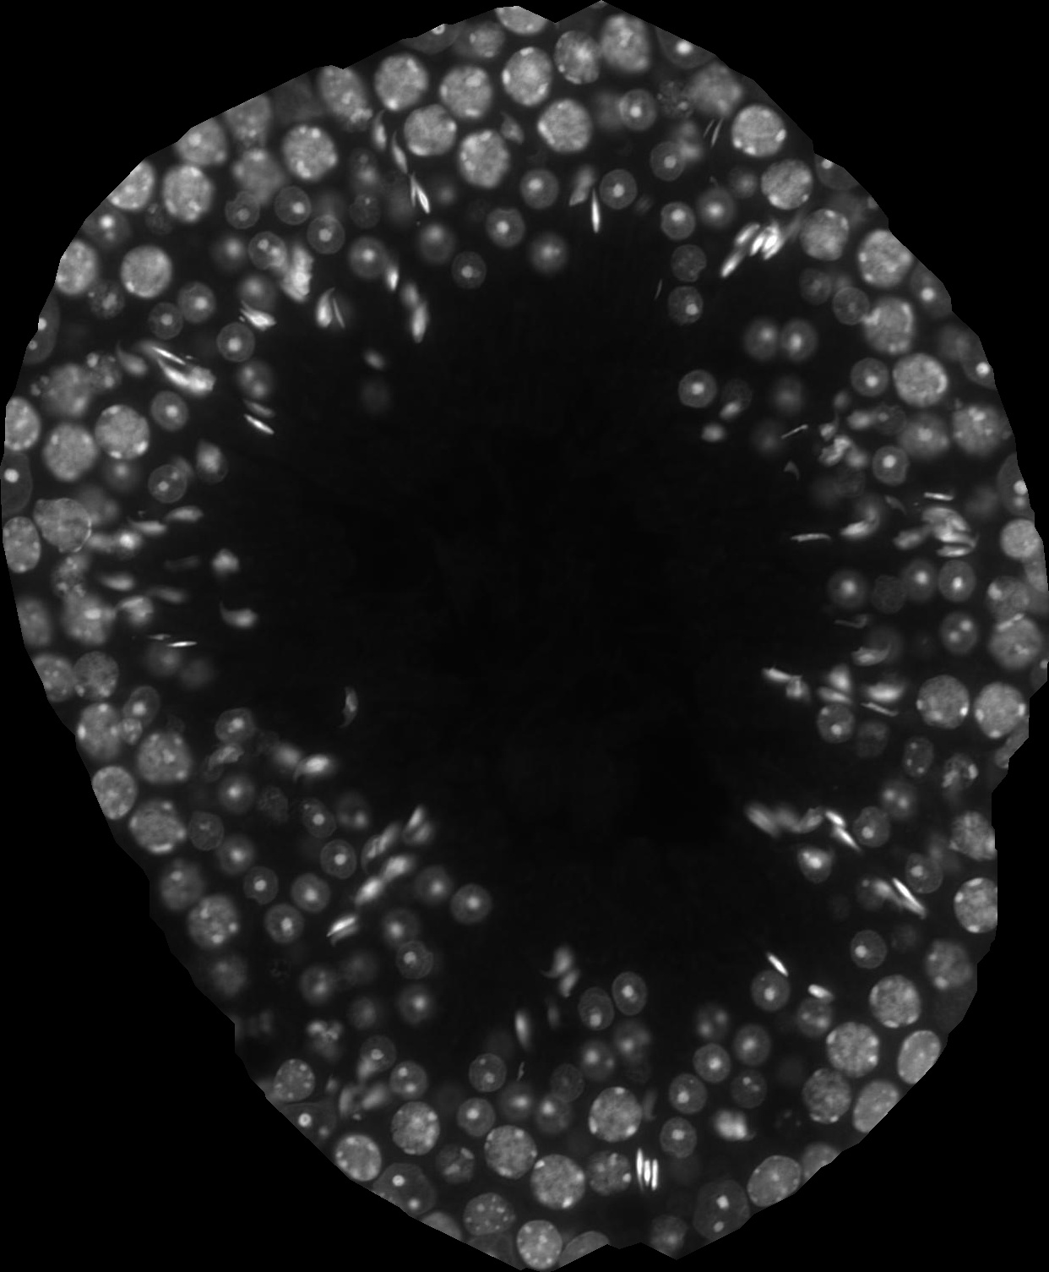
Criteria
Presence of Spg, pachytene Spc, RS and late condensed elSpt which are in bundles. Pachytene Spc are relatively small (I-IV) but gradually grow in size towards stage V.
STAGES I-V
Stage I
Stage II-V

Slide 17
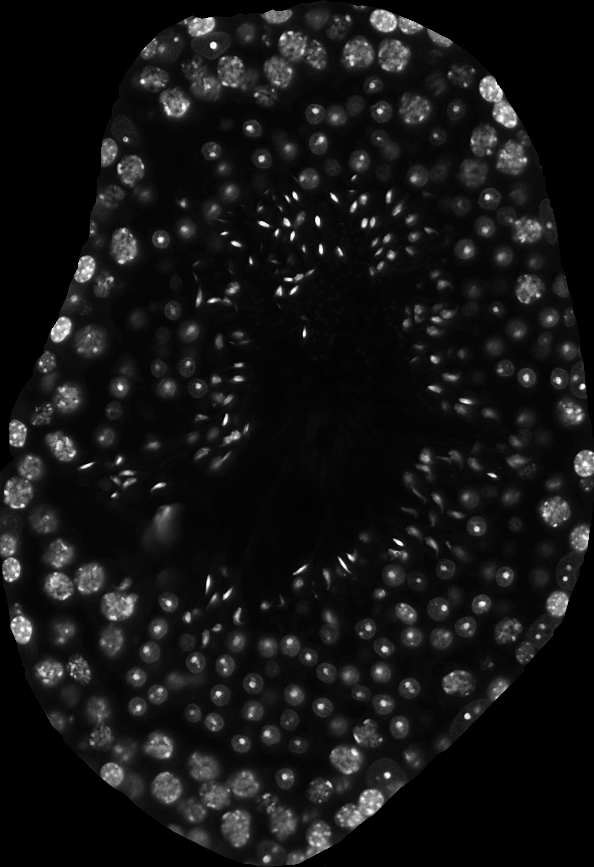
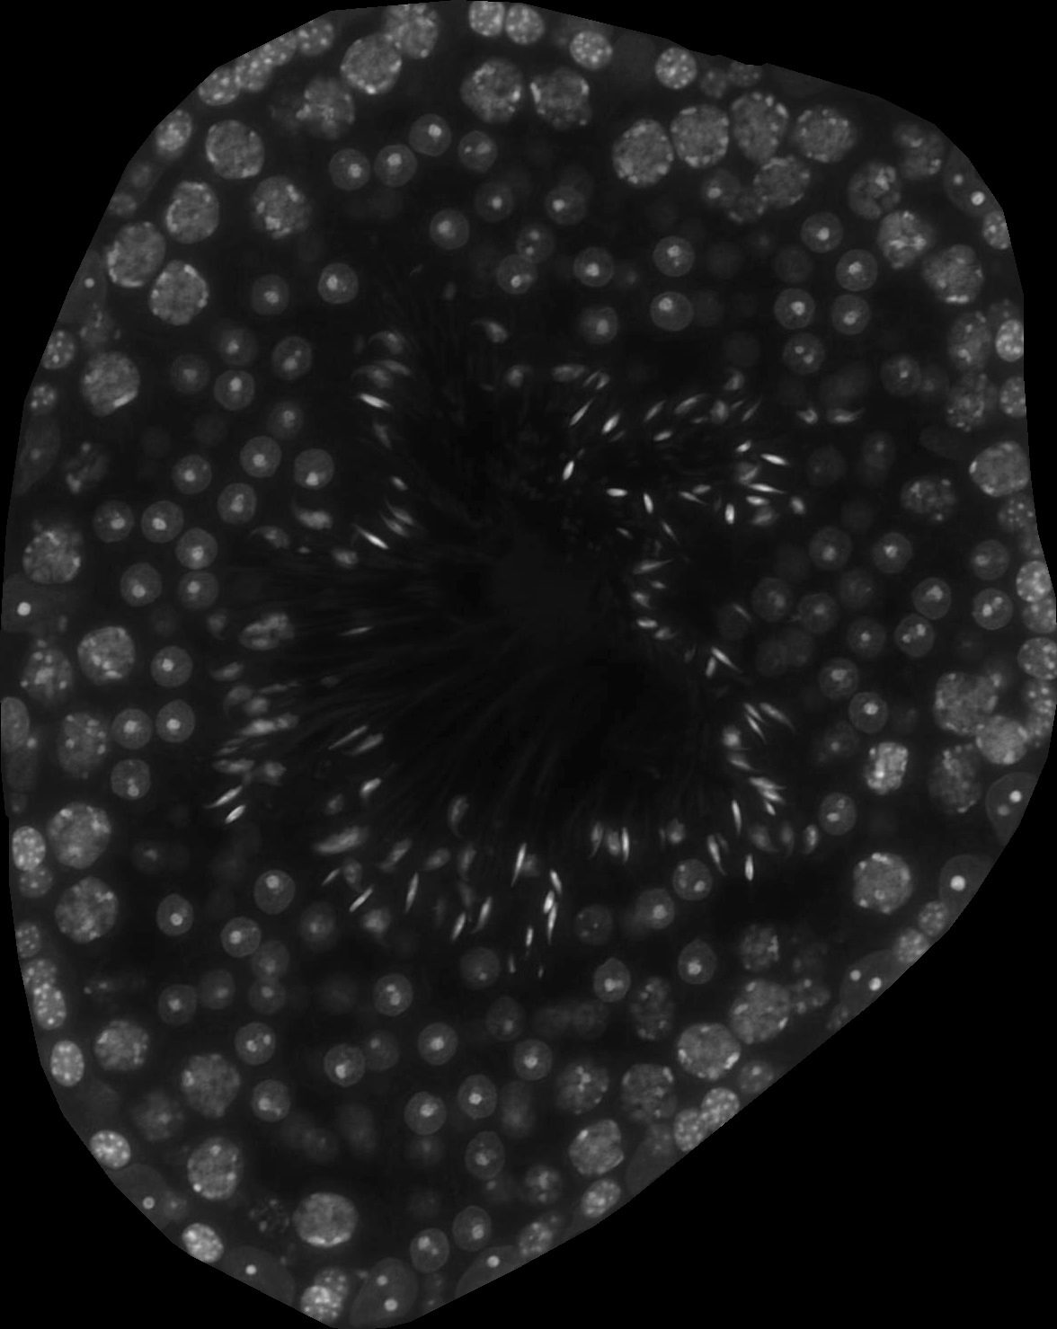
Criteria
elSpt are no longer in bundles and start to align (VI) or are aligned (VII-VIII) at the luminal edge of the epithelium, type B Spg or preleptotene Spc on the basement membrane, pachytene Spc large in size.
STAGES VI-VIII
Stage VI
Stage VII-VIII

Slide 18
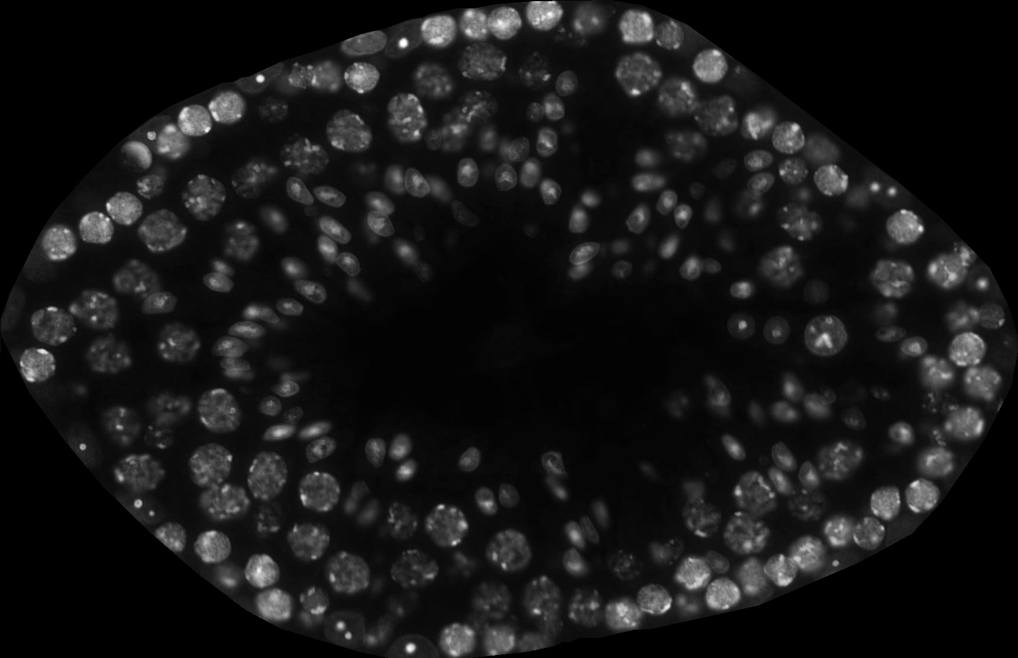
Criteria
Start of spermatid elongation, lack of RS and late condensed elSpt. Late Spc large and early Spc small.
STAGE IX
Early
Stage IX
Late
Stage IX

Slide 19
Criteria
Spermatids are elongated but not fully condensed and have a hooked tip, lack of RS. Late Spc very large and early Spc small in size.
STAGES X-XI
Stages X-XI

Slide 20
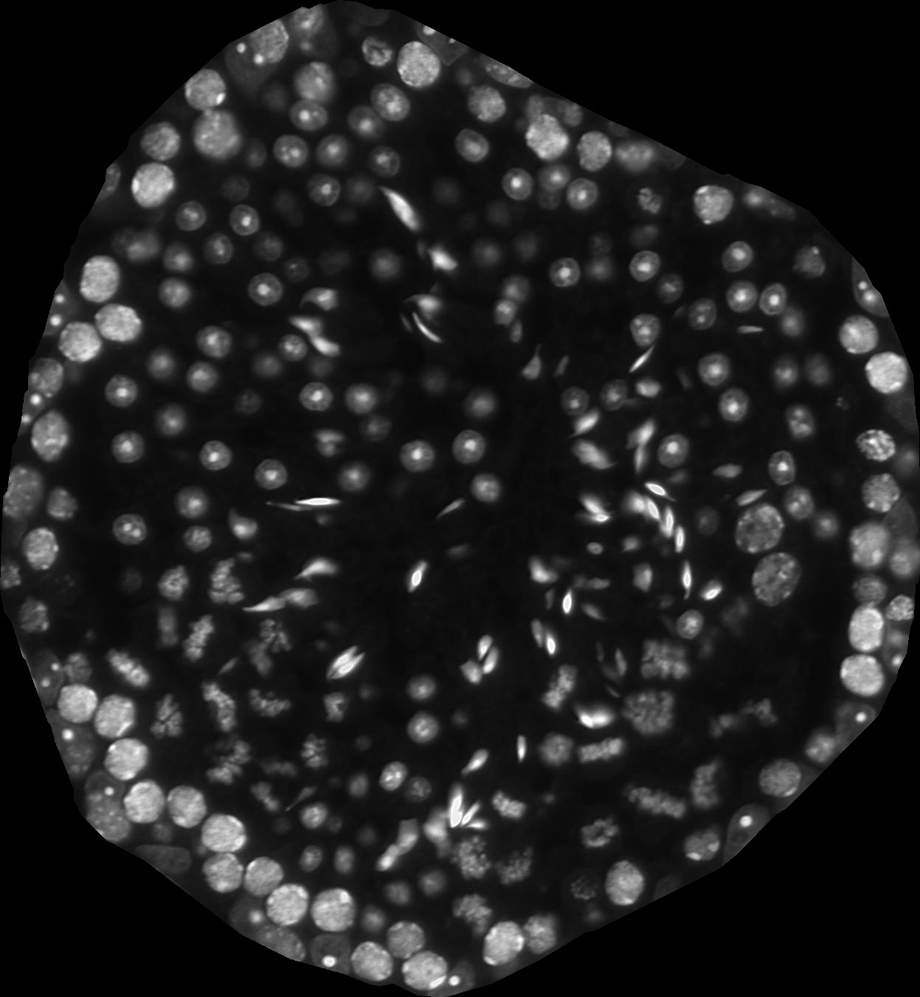
Criteria
Presence of cells undergoing meiotic divisions (metaphase plates) and/or secondary spermatocytes.
STAGE XII
Stage XII
Stage XII
Stage I

Slide 21
TROUBLE-SHOOTING
Despite very high performance STAGETOOL occasionally does mistakes. The most common mistakes done by STAGETOOL are:
1. Spc-Prepach vs. Spg
Preleptotene spermatocytes vs. spermatogonia. Drawing a distinction between these two cell types may sometimes be very challenging.
2. El-Spt-early vs. El-Spt-late
Early vs. late elongating spermatids. The former gradually develop into latter.
3. Sert vs. RS
Sertoli cells vs. round spermatids. In DAPI staining these two cell types sometimes look very similar but their localization within the epithelium is distinct and Sertoli cell nuclei are typically close to the basement membrane.
4. Stages I-V vs. VI-VIII.
Stages V-VI are very similar and might sometimes fall into either stage category.
Contact stagetool@utu.fi
The confusion matrices of the online version of STAGETOOL to be placed here. Both for cell models and tubule models.

Slide 22
WHOLE-TESTIS ANALYSIS & EXPRESSION PROFILING
Some text about these two topics and a encouragement to contact us if one wishes to do that.
Contact stagetool@utu.fi

Slide 23




DEVELOPERS
Sini Leskinen, B.Med.
Oliver Meikar, PhD
Funding:
Academy of Finland
Sigrid Jusélius Foundation
Estonian Research Council
Novo Nordisk Foundation
Jalmari and Rauha Ahokas Foundation
Pasi Kankaanpää, PhD
Junel Solis, PhD
Dado Tokic, MSc
…
Asst. Prof. Pekka Ruusuvuori, PhD
Daniel Majoral, MSc
Juho-Antti Mäkelä, PhD
Institute of Biomedicine and Translational Medicine & Institute of Computer Science
University of Tartu, Tartu, Estonia
Institute of Biomedicine, Integrative Physiology and Pharmacology Unit
University of Turku, Turku, Finland
Olli Heikkinen, B.Med.
Professor Noora Kotaja, PhD

Slide 24
CITATION
When using this tool for publication purposes, please acknowledge the developers by including the following citations:
Meikar O, Majoral D, Heikkinen O, Valkama E, Leskinen S, Rebane A, Ruusuvuori P, Toppari J, Mäkelä JA and Kotaja N. STAGETOOL, a novel automated approach for mouse testis histological analysis. Endocrinology 2022 164(2):bqac202. doi:10.1210/endocr/bqac202.
Meikar O et al.. XXXXXXXX. Bioinformatics 2024. XXXXXXXX

Slide 25
DESIGN OF STAGETOOL.UTU.FI

